Slide 1
Home work
If else
Switch case

Slide 2
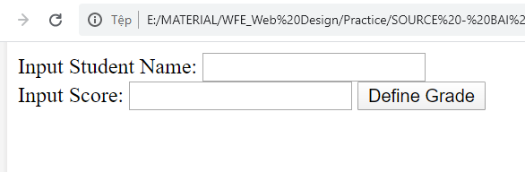
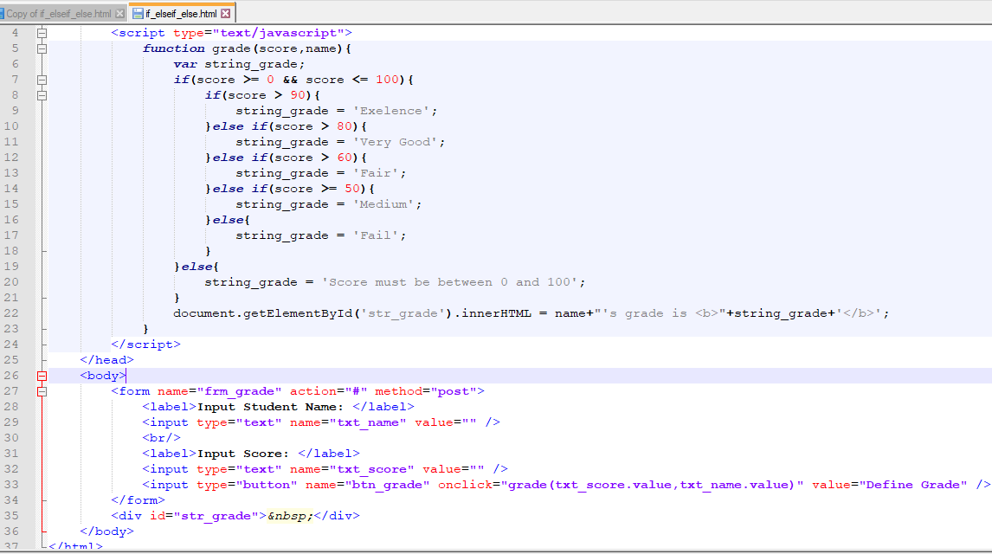
Activity # 1
Notes:
<html> <head> <title>If Else</title> <script type="text/javascript"> function grade(score,name){ var string_grade; if(score >= 0 && score <= 100){ if(score > 90){ string_grade = 'Exelence'; }else if(score > 80){ string_grade = 'Very Good'; }else if(score > 60){ string_grade = 'Fair'; }else if(score >= 50){ string_grade = 'Medium'; }else{ string_grade = 'Fail'; } }else{ string_grade = 'Score must be between 0 and 100'; } document.getElementById('str_grade').innerHTML = name+"'s grade is <b>"+string_grade+'</b>'; } </script> </head> <body> <form name="frm_grade" action="#" method="post"> <label>Input Student Name: </label> <input type="text" name="txt_name" value="" /> <br/> <label>Input Score: </label> <input type="text" name="txt_score" value="" /> <input type="button" name="btn_grade" onclick="grade(txt_score.value,txt_name.value)" value="Define Grade" /> </form> <div id="str_grade">&nbsp;</div> </body></html>

Slide 3
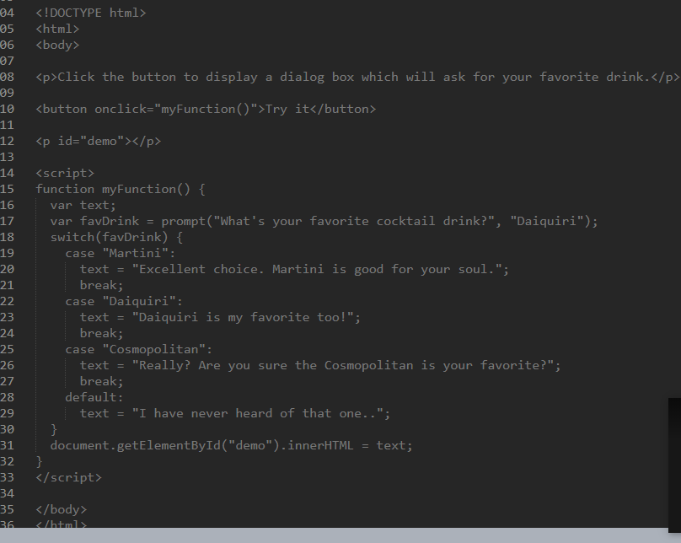
Activity # 2

Slide 4
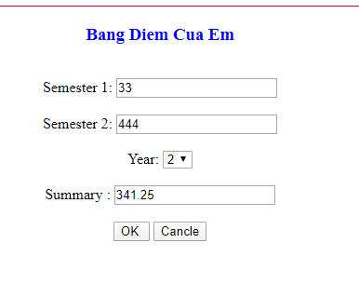
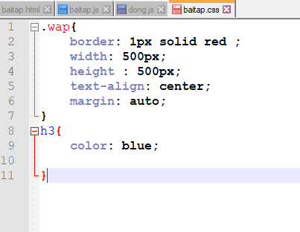
Activity # 3

Slide 5
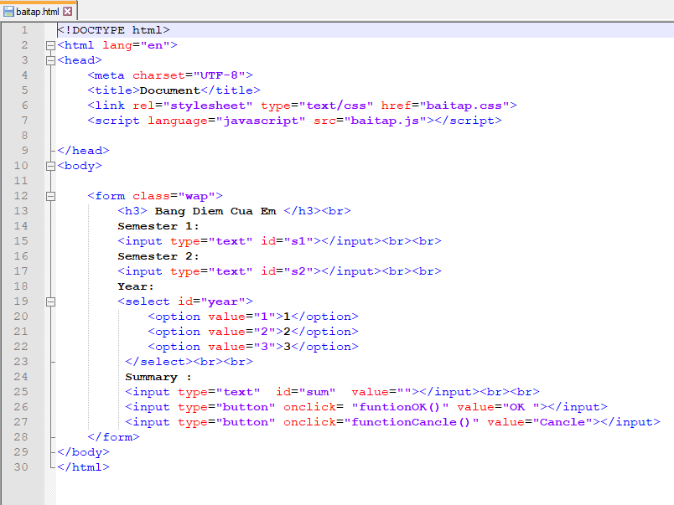
Notes:
<!DOCTYPE html>
<html lang="en">
<head>
<meta charset="UTF-8">
<title>Document</title>
<link rel="stylesheet" type="text/css" href="baitap.css">
<script language="javascript" src="baitap.js"></script>
</head>
<body>
<form class="wap">
<h3> Bang Diem Cua Em </h3><br>
Semester 1:
<input type="text" id="s1"></input><br><br>
Semester 2:
<input type="text" id="s2"></input><br><br>
Year:
<select id="year">
<option value="1">1</option>
<option value="2">2</option>
<option value="3">3</option>
</select><br><br>
Summary :
<input type="text" id="sum" value=""></input><br><br>
<input type="button" onclick= "funtionOK()" value="OK "></input>
<input type="button" onclick="functionCancle()" value="Cancle"></input>
</form>
</body>
</html>

Slide 6
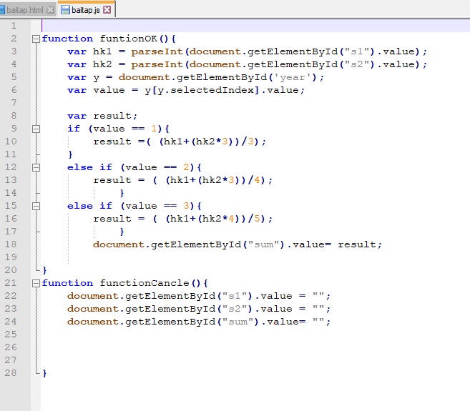
Notes:
function funtionOK(){
var hk1 = parseInt(document.getElementById("s1").value);
var hk2 = parseInt(document.getElementById("s2").value);
var y = document.getElementById('year');
var value = y[y.selectedIndex].value;
var result;
if (value == 1){
result =( (hk1+(hk2*3))/3);
}
else if (value == 2){
result = ( (hk1+(hk2*3))/4);
}
else if (value == 3){
result = ( (hk1+(hk2*4))/5);
}
document.getElementById("sum").value= result;
}
function functionCancle(){
document.getElementById("s1").value = "";
document.getElementById("s2").value = "";
document.getElementById("sum").value= "";
}

Slide 7
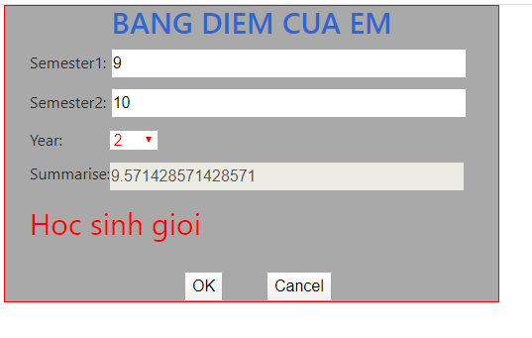
Activity # 4
Notes:
<!DOCTYPE html>
<html>
<head>
<meta charset="utf-8">
<meta http-equiv="X-UA-Compatible" content="IE=edge">
<title></title>
<link rel="stylesheet" href="./bootstrap-4.0.0-alpha.6-dist/bootstrap-4.0.0-alpha.6-dist/css/bootstrap.min.css">
<script src="./bootstrap-4.0.0-alpha.6-dist/bootstrap-4.0.0-alpha.6-dist/js/bootstrap.min.js"></script>
<script src="./bootstrap-4.0.0-alpha.6-dist/bootstrap-4.0.0-alpha.6-dist/js/jquery.min.js"></script>
<link rel="stylesheet" type="text/css" href="Ex1_css.css">
<script src="Ex1_js.js"></script>
</head>
<body>
<div class="container">
<h1>BANG DIEM CUA EM</h1>
<div id="input">
<span>Semester1:</span>
<input type="text" name="inputa" id="text_1" size="40px">
</div>
<div id="input">
<span>Semester2:</span>
<input type="text" name="inputa" id="text_2" size="40px">
</div>
<div id="input">
<div id="form-horizontal">
<div class="row">
<div class="col-sm-2">
<span>Year:</span>
</div>
<div class="col-sm-2">
<select style="width: 50px; color: red" id="select">
<option value="1">1</option>
<option value="2">2</option>
<option value="3">3</option>
</select>
</div>
<div class="col-sm-8">
</div>
</div>
</div>
</div>
<div id="input">
<div id="form-horizontal">
<div class="row">
<div class="col-sm-2">
<span>Summarise:</span>
</div>
<div class="col-sm-10">
<input type="text" name="result" id="result" size= "40" disabled="true">
</div>
</div>
</div>
</div>
<div id="input">
<div id = "form-horizontal">
<div class="row">
<div class="col-sm-10">
<p id="display">
</div>
</div>
</div>
</div>
<div id="form-horizontal">
<div class="row">
<div class="col-sm-4">
</div>
<div class="col-sm-2">
<input type="button" name="ok" id="ok" value="OK" onclick="myFunction1()">
</div>
<div class="col-sm-2">
<input type="button" name="cancel" id="cancel" value="Cancel" onclick="myFunction2()">
</div>
</div>
</div>
</div>
</body>
</html>

Slide 8
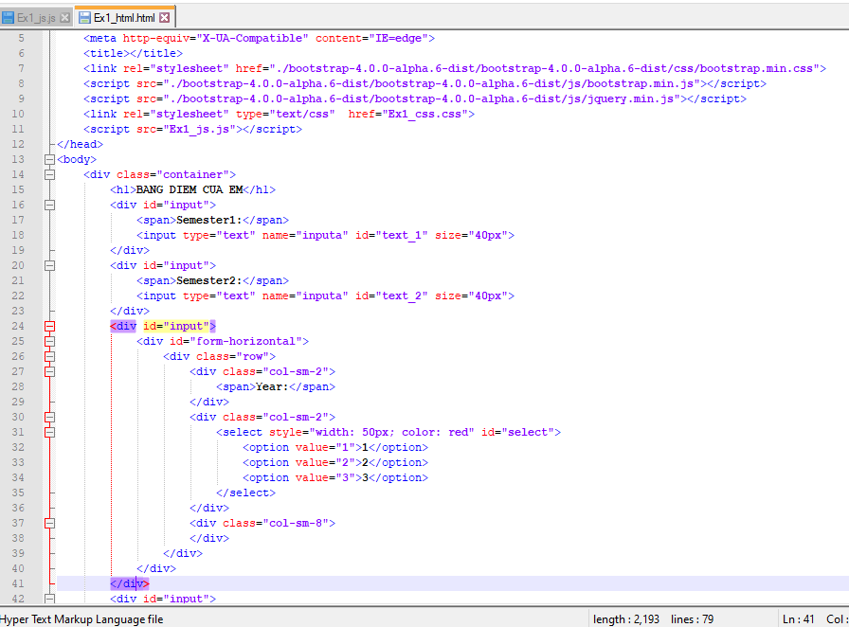

Slide 9
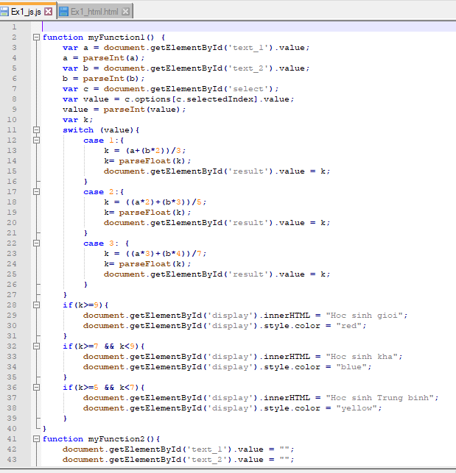
Notes:
function myFunction1() {
var a = document.getElementById('text_1').value;
a = parseInt(a);
var b = document.getElementById('text_2').value;
b = parseInt(b);
var c = document.getElementById('select');
var value = c.options[c.selectedIndex].value;
value = parseInt(value);
var k;
switch (value){
case 1:{
k = (a+(b*2))/3;
k= parseFloat(k);
document.getElementById('result').value = k;
}
case 2:{
k = ((a*2)+(b*3))/5;
k= parseFloat(k);
document.getElementById('result').value = k;
}
case 3: {
k = ((a*3)+(b*4))/7;
k= parseFloat(k);
document.getElementById('result').value = k;
}
}
if(k>=9){
document.getElementById('display').innerHTML = "Hoc sinh gioi";
document.getElementById('display').style.color = "red";
}
if(k>=7 && k<9){
document.getElementById('display').innerHTML = "Hoc sinh kha";
document.getElementById('display').style.color = "blue";
}
if(k>=5 && k<7){
document.getElementById('display').innerHTML = "Hoc sinh Trung binh";
document.getElementById('display').style.color = "yellow";
}
}
function myFunction2(){
document.getElementById('text_1').value = "";
document.getElementById('text_2').value = "";
document.getElementById('result').value = "";
document.getElementById('display').innerHTML = "";
}

